Slide 1
Machine Learning Part IV Unsupervised Learning K-means, PCA

Slide 2
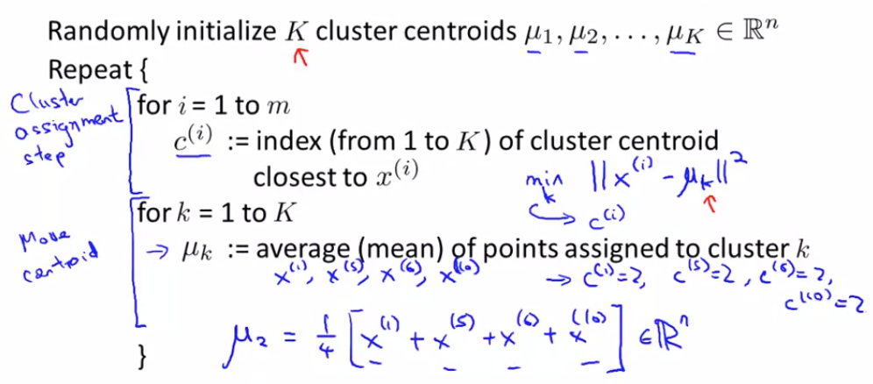
K-means Algorithm

Slide 3
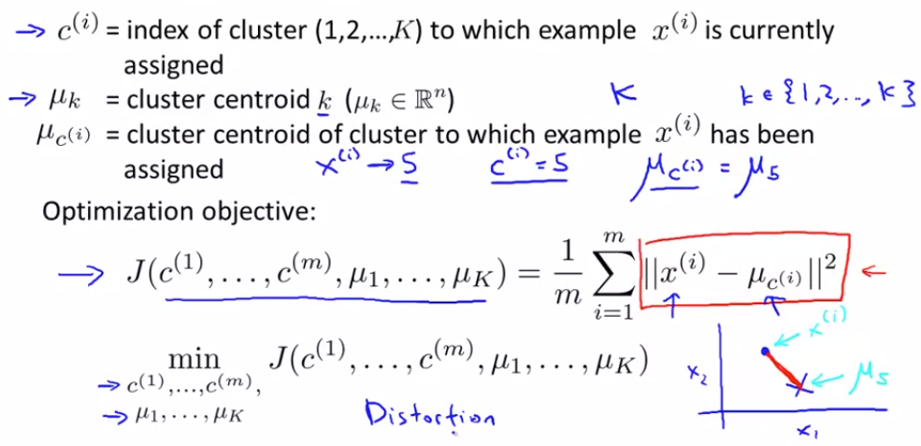
Optimization Objective

Slide 4
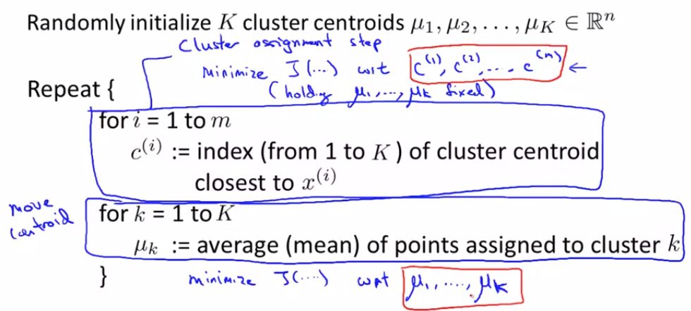
Optimization Objective

Slide 5
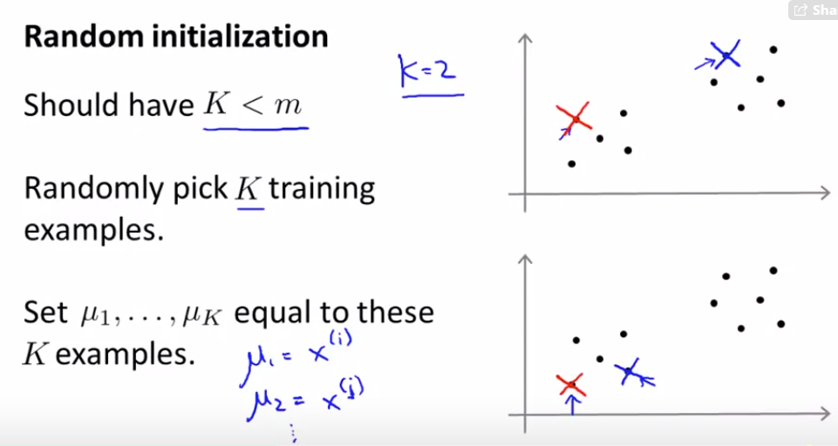
Random Initialization

Slide 6
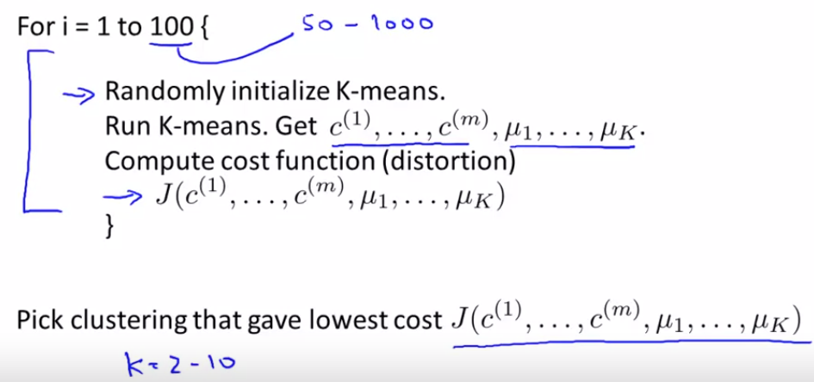
Multiple Random Initialization

Slide 7
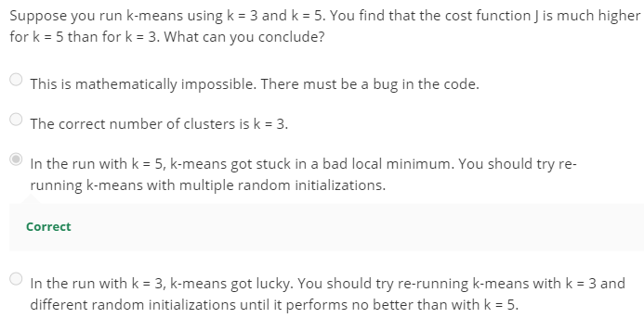
Choosing number of clusters

Slide 8
Application
Customer segmentation
Topic group
Image compression (as in ex7)

Slide 9
Principal Component Analysis

Slide 10
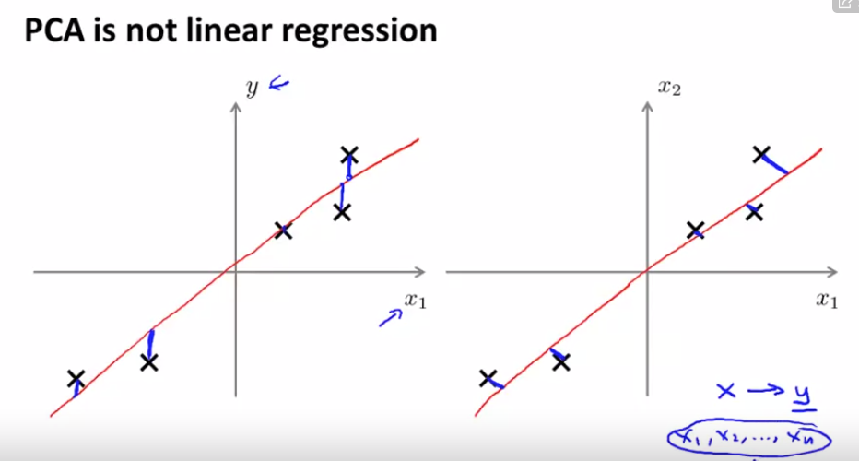

Slide 11
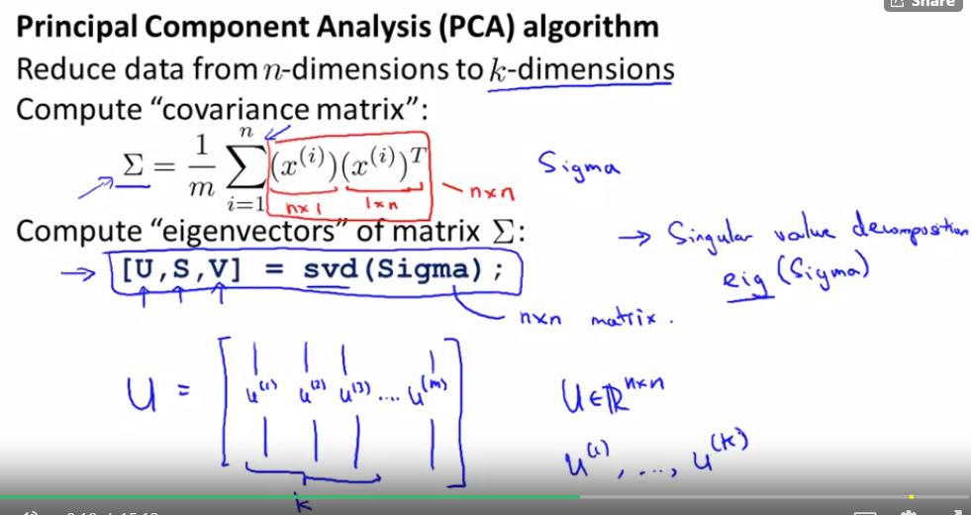




Slide 12
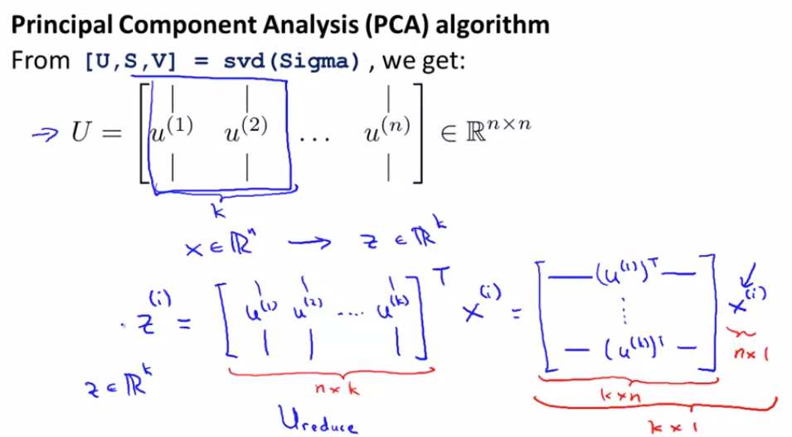
Z = X * U[:, 1:K]
X is m by n,
U is n by k,
Z is m by k

Slide 13
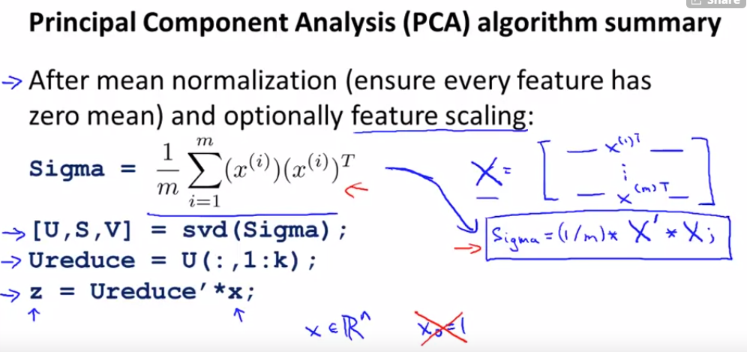

Slide 14
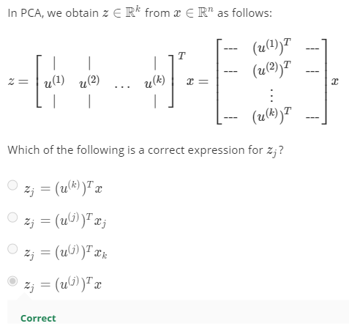

Slide 15
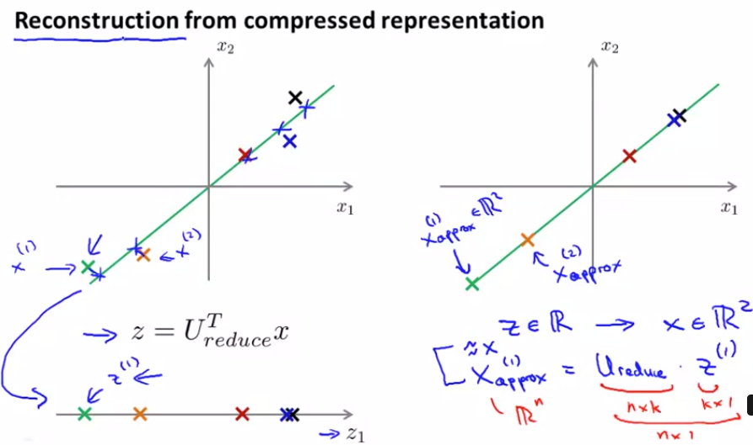

Slide 16
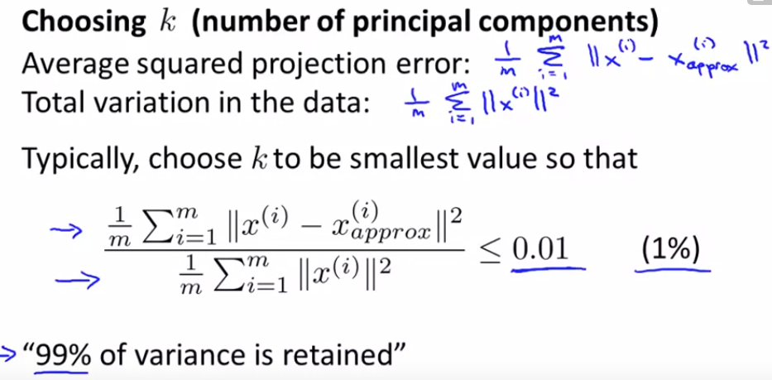

Slide 17
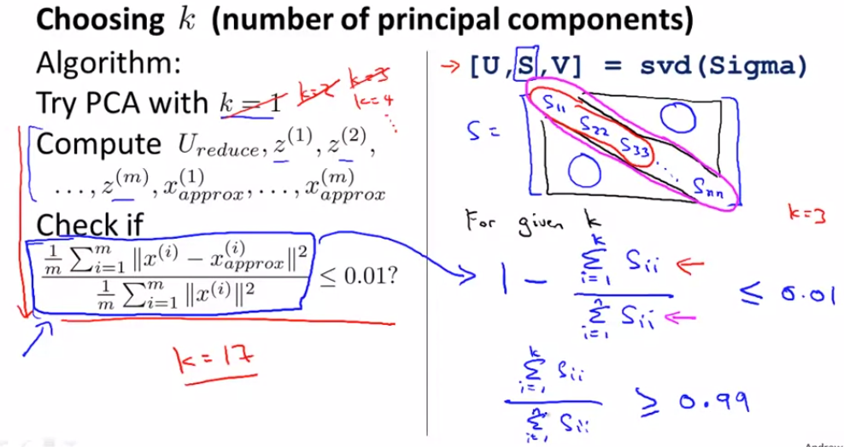

Slide 18
